Slide 1
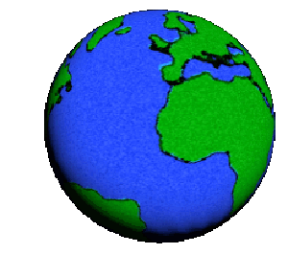
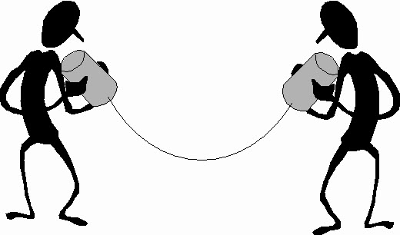
Communication
Channels
And its types
10 JULY 2026

Slide 2
Learning Objectives
By the end of this lesson, you should be able to:
Define a communication channel
Explain the importance of CCs
Identify the two main types of transmission media
Differentiate between guided & unguided media
Notes:
Every time you make a phone call, send a WhatsApp message, browse the internet, or watch a YouTube video, the data must travel through a communication channel before it reaches its destination.
A communication channel is simply the path or medium that carries information from the sender to the receiver.
Communication channels can be physical, such as cables, or wireless, such as radio waves and satellites. Throughout this lesson, we will explore the different types of communication channels, how they work, their advantages, disadvantages, and where they are commonly used."

Slide 3

What is Communication Channel ?
Transfers data or information from one place to another
Also known as Transmission Media
Sender
Receiver
Channel
Notes:
Before we discuss the different types of communication media, we first need to understand how communication takes place.
Communication is simply the process of transferring information from one point to another.
Every communication system has three basic components:
First, there is the Sender. The sender is the person or device that creates and sends the information.
Second, there is the Communication Channel. This is the path through which the information travels.
Finally, there is the Receiver, which is the person or device that receives the information."

Slide 4
Reasons For Transmission Impairment
Attenuation
Distortion during signal propagation
Noise
Notes:
This slide explains why signals lose quality as they travel from the sender to the receiver

Slide 5
In an ideal world, data would travel from S to R without any problems.
In real communication systems, signals often become weaker or distorted as they travel.
This reduction in signal quality is known as transmission impairment.
Can cause slow internet speeds,
  Poor quality phone calls
  Video buffering
  Communication failure
  ( attenuation, distortion and noise)

Slide 6
Attenuation
Is the gradual loss of signal strength as the signal travels over a long distance.
“the farther the signal travels, the weaker it becomes”
Solution
To overcome attenuation, networks use:
  Repeaters
  Amplifiers
These devices strengthen the signal before it becomes too weak
Notes:
Example
Think of shouting to a friend.
When they are 5 metres away, they hear you clearly.
When they are 500 metres away, your voice becomes very weak.
The same thing happens to data signals.

Slide 7
Distortion
Occurs when parts of a signal arrive at various times, causing the original message to change shape.
example:
Imagine sending the word “computer”
if some letters arrive later than others, the receiver may receive “comptuer”

Slide 8
Distortion
Causes
Different frequencies travel at different speeds.
Poor-quality transmission media.
Long transmission distances.
Effects
Poor voice quality during calls.
Corrupted files.
Video glitches.
Delayed communication.

Slide 9
Noise
Noise is any unwanted electrical or electromagnetic signal that interferes with the original signal.
Noise mixes with the real signal, making it difficult for the receiver to understand the message.
Everyday Examples
Static noise on a radio
Buzzing during phone calls
Electrical interference from power lines
Lightning during storms
Electromagnetic interference from electronic devices

Slide 10
Effects
Data errors
Lost packets
Reduced network performance
Poor audio and video quality

Slide 11
TYPES OF TRANSMISSION MEDIA
Transmission
Media
GUIDED
MEDIA
UNGUIDED
MEDIA
Notes:
Transmission media refers to the physical or wireless path through which data travels from the sender to the receiver.
The main difference between them is whether the signal travels through a physical cable or through the air (wirelessly).

Slide 12
GUIDED MEDIA (wired communication)
Twisted Pair Cable
Fiber Optic Cable
Coaxial
Cable
Notes:
Uses physical cables to carry signals from S to R

Slide 13
Characteristics
Uses cables
Faster & more reliable
Less interference
More secure
Limited by cable length
( ethernet cable connecting a desktop computer to a router,
Fiber internet installed in homes & offices, telephone landlines cables)

Slide 14
Unguided media (wireless communication)
Unguided media transmit signals through the air using electromagnetic waves.
No physical cable is required
Examples
Radio waves
Microwaves
Infrared
Satellite communication
Notes:
wi-fi
Bluetooth
Mobile phone networks (5g)
GPS navigation

Slide 15
Activity
Which type of transmission media does your university computer lab use?
Which type do you use most when browsing on your smartphone?
Why do businesses often use wired connections for their servers instead of wi-fi?
Notes:
Faster speeds, more reliable, better security, low latency, less interference
Not all communication requires cables. Modern networks often combine guided and unguided media.
For example, when you use your smartphone at home:
Your phone connects to the Wi-Fi router wirelessly (unguided media).
The router then connects to the internet through a fibre optic cable (guided media).

Slide 16
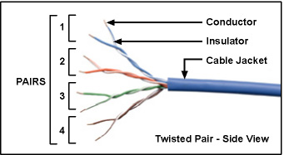
Twisted Pair Cable
Made of pairs of twisted copper wires
Consists of two insulated copper wires twisted around each other.
Twisted to reduce electromagnetic interference known as crosstalk,

Slide 17
APPLICATIONS
Local area networks
Telephone landlines, CNs
Can transmit ~ 1 Mbps over short distances
Mainly used for transmitting analog signals

Slide 18
Advantages
Low cost
Easy to install & maintain
Flexible & lightweight
Widely available
Drawbacks
Limited transmission distance
Lower bandwidth than fiber optic cables
Susceptible to electromagnetic interference
Lower transmission speed

Slide 19
Coaxial cable
Has a more complex structure that protects the signal from external interference.
Makes it suitable for transmitting data over longer distances at high speeds.
Used in television systems
  Cable internet
  CCTV installation
  Some one computer networks

Slide 20
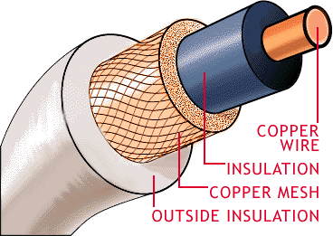
Structure
Copper core (conductor)
  Carries electrical signal
  Insulating layer (dielectric)
    Prevents signal from escaping
    Braided metal shield
      Reduce noise & protect signal from electromagnetic interference
      Outer plastic cover (jacket)
        Protects the cable from physical damage

Slide 21
CHARACTERS
Bandwidth:
80 times greater than that of twisted pair cables
Speed:
Data transmission speed is ~10Mbps.
Modern CC systems used ISPs support much higher speeds exceeding 10 Mbps through technologies such as DOCSIS.

Slide 22

BENEFITS
Higher bandwidth than twisted pair cables
Better protection against interference
More reliable over longer distances
Durable & robust
Can carry multiple signals simultaneously

Slide 23
DRAWBACKS
More expensive than twisted pair cables
Thicker & less flexible
More difficult to install
Slower & lower capacity than fiber optic cables

Slide 24
FIBER OPTIC CABLE
Made of very thin strands of glass or plastic called optical fibers.
These fibers carry information as pulses of light instead of electricity
Because light travels extremely fast,
Fiber optic communication provides much higher data rates than copper cables.

Slide 25
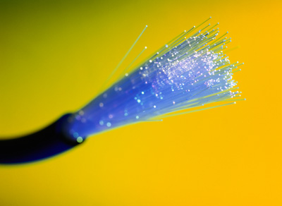
Fiber-Optic Cable
Uses reflection to guide light through a channel
Core is of glass or plastic surrounded by Cladding
Cladding is of less dense glass or plastic

Slide 26
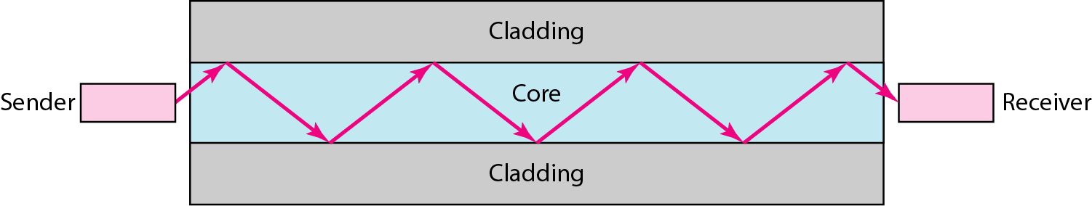
Transmission in Fiber-Optic Cable
Transmission Speed: Upto billion bits per second
Notes:
Imagine shining a torch into one end of a long glass tube. Instead of the light escaping through the sides, it keeps bouncing off the inner walls until it reaches the other end. Fibre optic cables work in a similar way, allowing light to travel long distances while staying inside the fibre."

Slide 27
APPLICATIONS & BENEFITS
Greater capacity(supports very high data rates)
Smaller size & lighter weight than copper cables
Lower attenuation, signal can travel much farther before needing amplification.

Slide 28
Drawbacks
More expensive to install
Fragile compared to copper cables
Requires specialised equipment & skilled technicians
Repairs can be more difficult

Slide 29
Applications
High-speed internet (fiber to the home)
Telephone backbone networks
Data centers
Banking networks
University & corporate networks
Cloud computing infrastructure

Slide 30
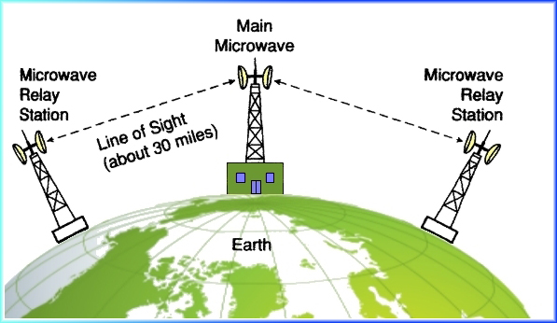


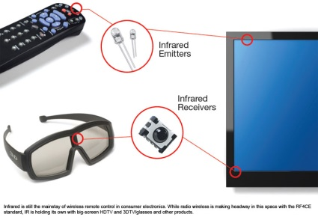
UNGUIDED MEDIA
Microwaves
Satellites
Radiowaves
Infra Red
Notes:
Unguided media is commonly known as wireless communication because no physical cable connects the sender and receiver.
Everyday we use wi-fi
Bluetooth,
Mobile phone,
Gps, satellite tv

Slide 31
Definition
Unguided media is a transmission medium in which electromagnetic waves carry data through free space without using physical cables.
Supports mobility
Easy & quick to install
Can cover short or very long distances
More susceptible to interference
  Obstacles & weather conditions

Slide 32
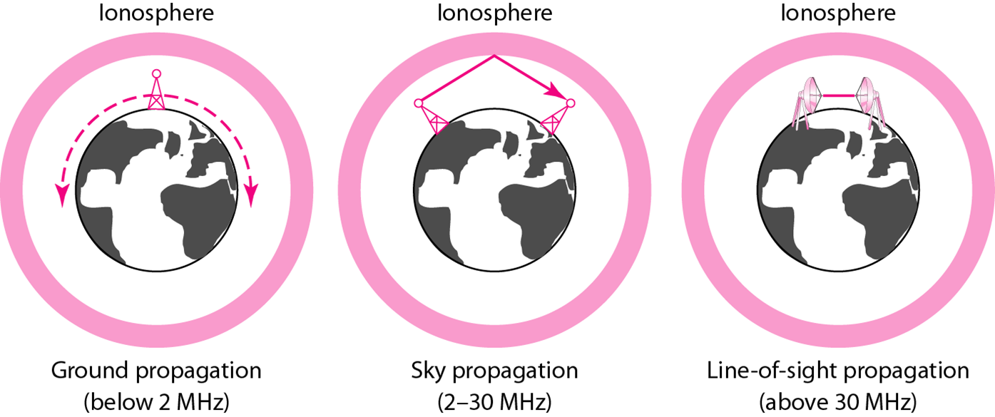
PROPAGATION METHODS

Slide 33
MICROWAVES TRANSMISSION
  Microwave Relay Stations
  Height of 40-50ft
  Spaced at least 20-30miles apart
Notes:
Line-of-sight communication means there must be a clear, direct path
Since microwave signals cannot follow the Earth's curvature, relay towers are built at regular intervals. Each tower receives the signal, strengthens it, and forwards it to the next tower."

Slide 34
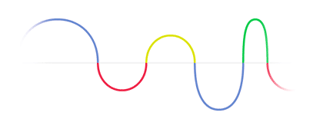
How microwave transmission works
A transmitting antenna sends microwave signals.
The signals travel through the air in a straight line.
A microwave relay tower receives the signal.
The relay tower amplifies or regenerates the signal.
The signal is then transmitted to the next relay tower.
This process continues until the signal reaches its final destination.
Notes:
If an object blocks the path, communication may fail.
Examples of obstacles:
Mountains
Tall buildings
Trees
Hills
Flashing a light to your friend, if someone stands in between you the light is blocked

Slide 35
Characteristics
Microwave signals are transmitted via relay stations.
Microwaves are unidirectional (they travel in one direction).
Microwave propagation requires line of sight.
Very high-frequency microwaves cannot penetrate walls.
Data transmission speed is approximately 150 Mbps.

Slide 36
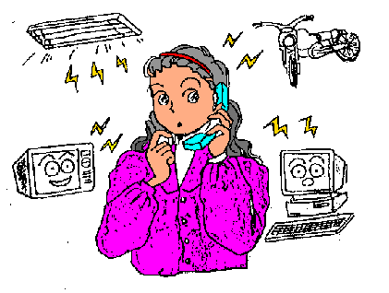
BENEFITS
High-speed data transmission.
Suitable for long-distance communication.
No need to install cables across difficult terrain.
Faster and less expensive to deploy than laying fiber in some remote areas.
Supports point-to-point communication.

Slide 37
Drawbacks
Requires a clear line of sight.
Weather conditions (heavy rain or storms) can reduce signal quality.
Obstacles such as buildings or mountains can block the signal.
Limited transmission distance before another relay station is needed.

Slide 38
Communication satellite
An artificial satellite placed in orbit around the Earth that receives, amplifies, and retransmits communication signals between different locations.
A transmitting Earth station sends a signal up to the satellite (called the uplink).
The satellite receives the signal.
The satellite amplifies or regenerates the signal.
The satellite sends the signal back to another Earth station (called the downlink).

Slide 39
Simple analogy
Imagine you are standing on one side of a mountain and your friend is on the other side. You cannot see or talk to each other directly. A person standing on top of the mountain can hear your message and pass it to your friend.
The satellite performs a similar role—it receives a message and forwards it to another location.

Slide 40
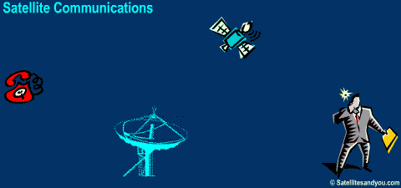
COMMUNICATION SATELLITES

Slide 41
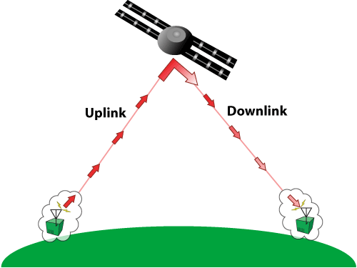
CHARACTERS
Signals are transmitted from Earth stations to Satellites
Data transmission speed is upto 1Gbps.
Notes:
Modern communication satellites can support much higher data rates depending on the satellite system and technology used.

Slide 42
Advantages
Transmits large amounts of data.
Very high data transmission speed.
Covers very large geographical areas.
Connects remote locations where laying cables is difficult.
Supports global communication.
Enables broadcasting to millions of users simultaneously.

Slide 43

DISADVANTAGES:
Effected by bad weather.
Have security problems.
It is costly.
Heavy rain can weaken satellite signals
Launching & maintaining satellites is expensive
Signals travel long distances, introduction a small delay

Slide 44
RADIO WAVES
Oldest & mostly used forms of wireless communication
They can travel long distances
They can often pass through walls and other obstacles

Slide 45

BROADCAST RADIO
Used to send signals over long & short distances.
The transmitter converts information (voice, music, or data) into radio waves.
The radio waves travel through the air.
The receiver captures the radio waves.
The receiver converts them back into sound or data.
Notes:
transmitter ( radio)
Receiver ( car radio)
Transceiver (both)
Mobile phones
walkie talkies

Slide 46
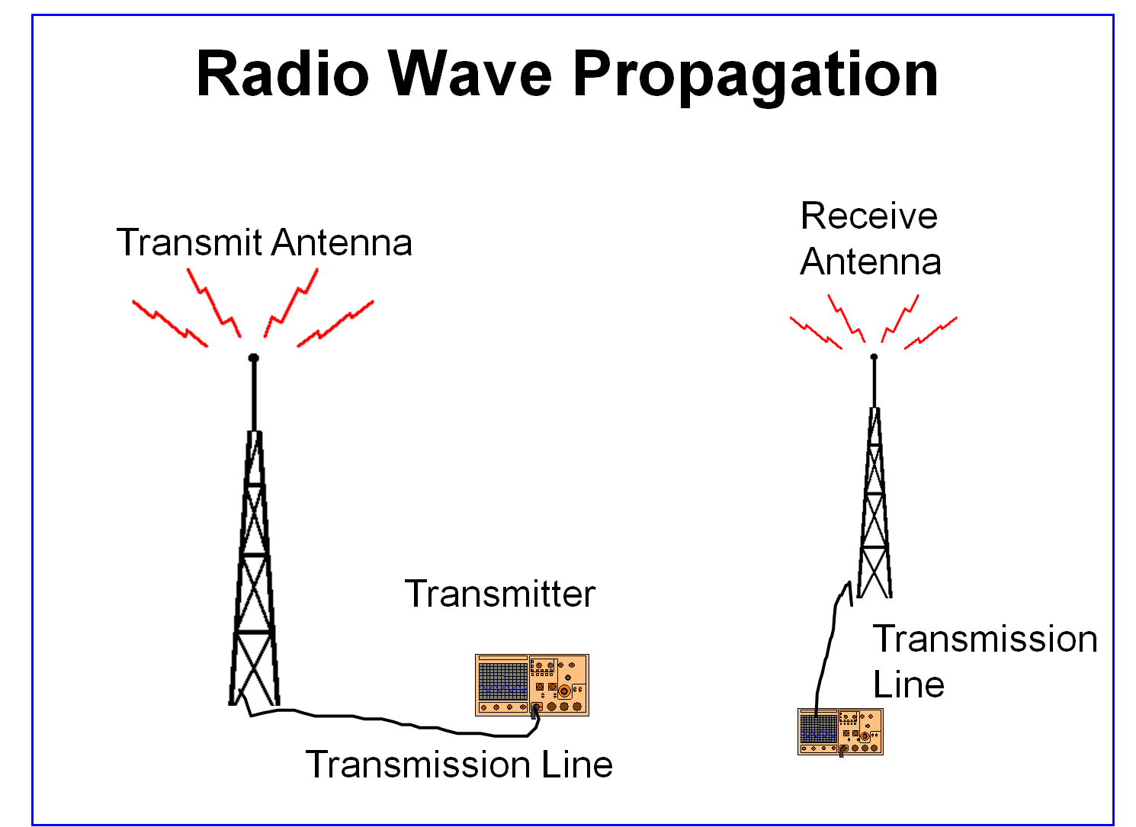
Transmission Rate: 1Mbps
Notes:
When you connect your wireless earbuds to your smartphone using Bluetooth, which type of device is each one?
Smartphone → Transceiver (sends and receives data).
Bluetooth earbuds → Transceivers (they receive audio and also send information such as battery status or microphone input).

Slide 47
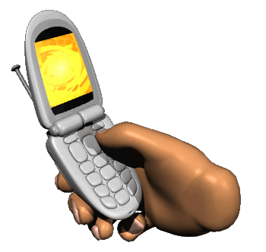
Cellular Radio
Making a call
Sending whatsap message
Browse the internet without wifi
You are using a cellular radio

Slide 48
Cellular radio
wireless communication technology that allows mobile devices to communicate through a network of cell towers (base stations).
Each cell has:
One cell tower
A specific coverage area
Users connected within that area
Notes:
Imagine looking at a city from above.
The area is divided into many small regions called cells.
When you move from one area to another, your phone automatically connects to the nearest cell tower.

Slide 49
You make a phone call.
Your phone sends radio signals to the nearest cell tower.
The cell tower forwards the information through the mobile network.
Another cell tower sends the signal to the receiver's phone.
Have you ever been on a phone call while travelling in a car or bus? Did the call continue without disconnecting?
Notes:
As you move, your phone automatically switches from one cell tower to another.
This process is called a handover (or handoff).
The handover happens so quickly that you usually don't notice it.

Slide 50

Infrared
Line of sight transmission
Short Range
Example:
Data transmission among a computer and wireless keyboard or mouse

Slide 51
CONCLUSION
Transmission media are essential for communication system.

Slide 52


